Slide 1

Lossless join and dependency preservation
Database Management System | Database Design and Advanced Normalization
Course: Database Management System | Chapter: Database Design and Advanced Normalization | Program: Bachelor of Engineering
DISCOVER · LEARN · EMPOWER
Notes:
Welcome everyone to today's lecture on Database Design. We are focusing on two critical properties: lossless join and dependency preservation. These concepts ensure our database decompositions are both safe and functional. Let's begin by understanding why these matter for data integrity.

Slide 2
Course Outcomes
SLIDE 2 / 14
Course Outcome
CO | BT LEVEL | DESCRIPTION
CO1 | BT2 | Explain database architecture, relational model concepts and formal query language foundations including relational algebra and relational calculus.
CO2 | BT3 | Apply relational algebra, relational calculus and SQL constructs to formulate correct and efficient database queries.
CO3 | BT4 | Analyze functional dependencies and design normalized relational schemas up to 5NF ensuring lossless join and dependency preservation.
CO4 | BT4 | Analyze transaction schedules and concurrency control mechanisms to determine serializability, recoverability and correctness.
CO5 | BT5 | Evaluate storage structures, indexing strategies and query optimization techniques for performance, scalability and reliability.
Chandigarh University
2 / 14
Notes:
Today's session directly addresses our Course Outcomes. CO1 requires you to explain the theoretical foundations of database architecture, which includes normalization theory. CO2 expects you to apply these concepts to formulate correct queries and designs. Mastering lossless joins ensures your designs meet these rigorous academic standards.

Slide 3
Learning Objectives
SLIDE 3 / 14
Learning Outcomes
1
Define the concept of lossless join decomposition in relational databases.
2
Identify the conditions required for a decomposition to be lossless.
3
Explain the necessity of dependency preservation in database normalization.
4
Distinguish between lossless and lossy join operations using examples.
5
Apply the chase algorithm to verify decomposition properties.
Chandigarh University
3 / 14
Notes:
By the end of this lecture, you will be able to define lossless joins clearly. You will learn to identify the specific conditions that prevent data loss. We will also explore dependency preservation and how to verify it. Finally, you will apply these rules to real-world database scenarios.

Slide 4
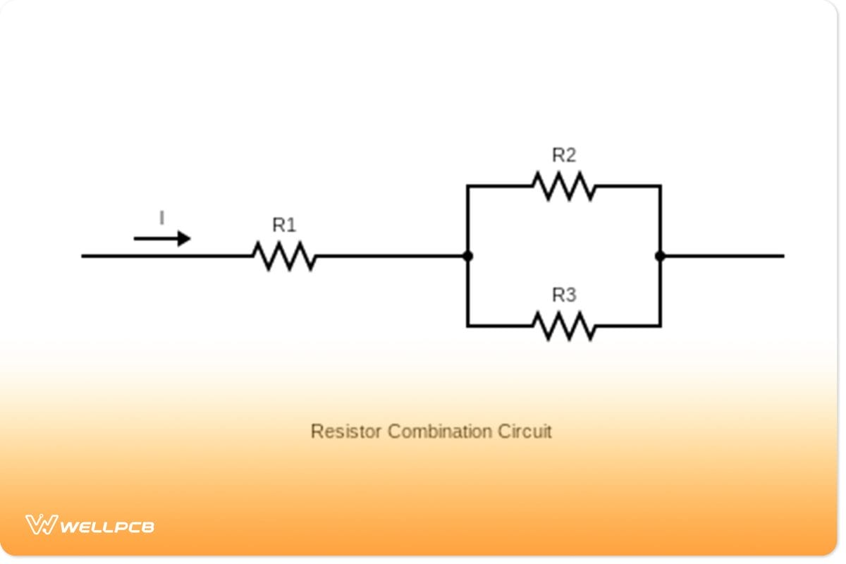
Lecture
SLIDE 4 / 14
Definition of Lossless Join
1
A decomposition is lossless if the natural join of sub-relations reconstructs the original relation.
2
No spurious tuples are generated during the join operation of decomposed tables.
3
The original data is fully recoverable without any information loss or duplication.
4
This property is essential for maintaining data integrity during schema decomposition.
5
Lossless join ensures that R equals the join of R1 and R2.
Electronic Resistor Circuits & Diagrams | PCB Project Guide
Chandigarh University
4 / 14
Notes:
Think of a lossless join like cutting a puzzle into two pieces. When you put them back together, you get the exact original picture. If you lose pieces or add fake ones, the picture is wrong. In databases, we must ensure the join reconstructs the original table perfectly.

Slide 5
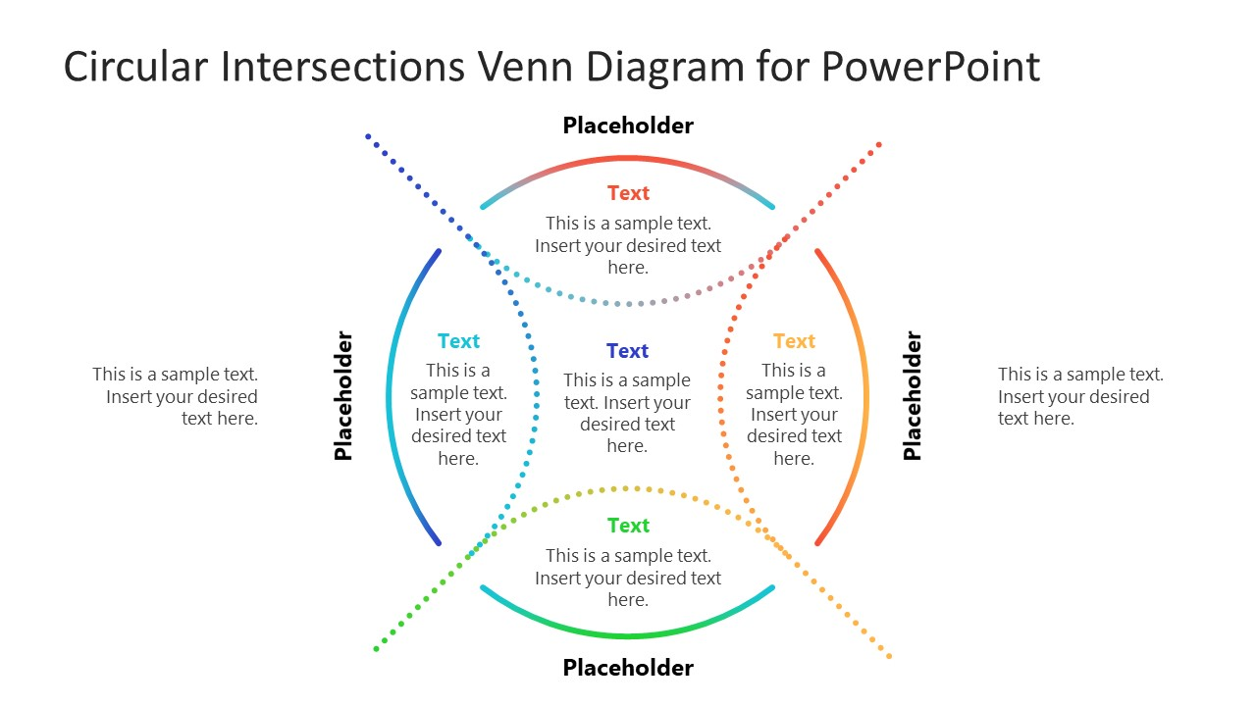
Lecture
SLIDE 5 / 14
Condition for Lossless Join
1
The intersection of attributes must be a superkey for at least one sub-relation.
2
If R1 ∩ R2 is a key for R1, the decomposition is guaranteed to be lossless.
3
If R1 ∩ R2 is a key for R2, the decomposition is also guaranteed to be lossless.
4
The common attributes must functionally determine all attributes in one of the relations.
5
Failure to meet this condition results in a lossy join with spurious data.
Source: slidemodel.com
Chandigarh University
5 / 14
Notes:
The golden rule is simple: the common attributes must act as a key for one of the parts. If the intersection is a key for R1, we are safe. This ensures that when we join, we don't create duplicate rows that didn't exist before. It is the mathematical guarantee of data safety.

Slide 6
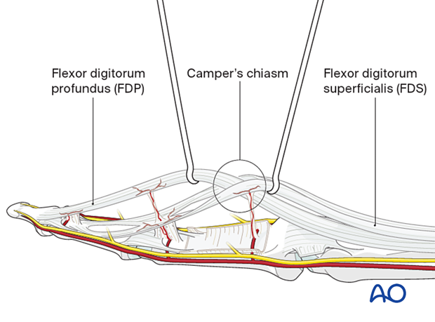
Lecture
SLIDE 6 / 14
Definition of Dependency Preservation
1
Dependency preservation ensures all functional dependencies hold in the decomposed schema.
2
Every functional dependency in the original set must be enforceable in the new tables.
3
We avoid the need to perform joins to check for constraint violations.
4
This property improves query performance by reducing join operations during updates.
5
A decomposition preserves dependencies if the union of projected dependencies covers the original set.
Source: media.aofoundation.org
Chandigarh University
6 / 14
Notes:
Dependency preservation is about keeping our rules intact. If we have a rule like 'Student ID determines Name', that rule must still be checkable without joining tables. If we lose this, we might insert invalid data without the database catching it. It is crucial for maintaining data quality efficiently.

Slide 7
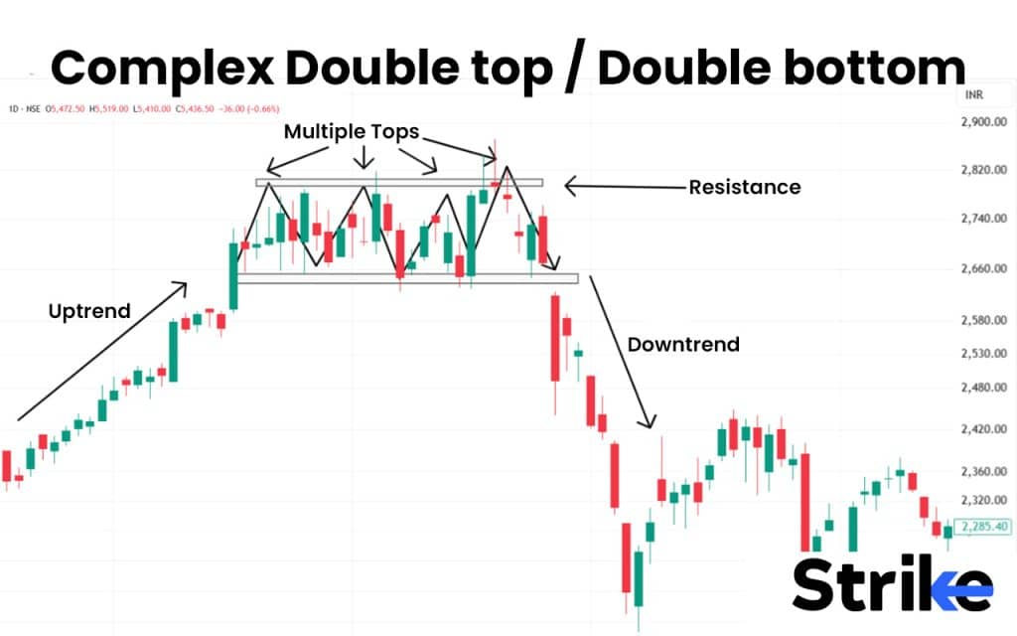
Lecture
SLIDE 7 / 14
Lossy Join vs Lossless Join
1
A lossy join generates spurious tuples that were not present in the original data.
2
Lossy joins occur when the intersection is not a superkey for either relation.
3
Lossless joins guarantee that the join result is exactly equal to the original relation.
4
Lossy joins lead to data redundancy and potential update anomalies in the system.
5
Always verify the intersection condition before finalizing a database decomposition strategy.
Source: www.strike.money
Chandigarh University
7 / 14
Notes:
Imagine a lossy join as a photocopy that gets blurry and adds extra lines. You end up with data that never existed. A lossless join is like a perfect copy where nothing is added or lost. We always aim for the lossless version to ensure our database remains accurate and reliable.

Slide 8
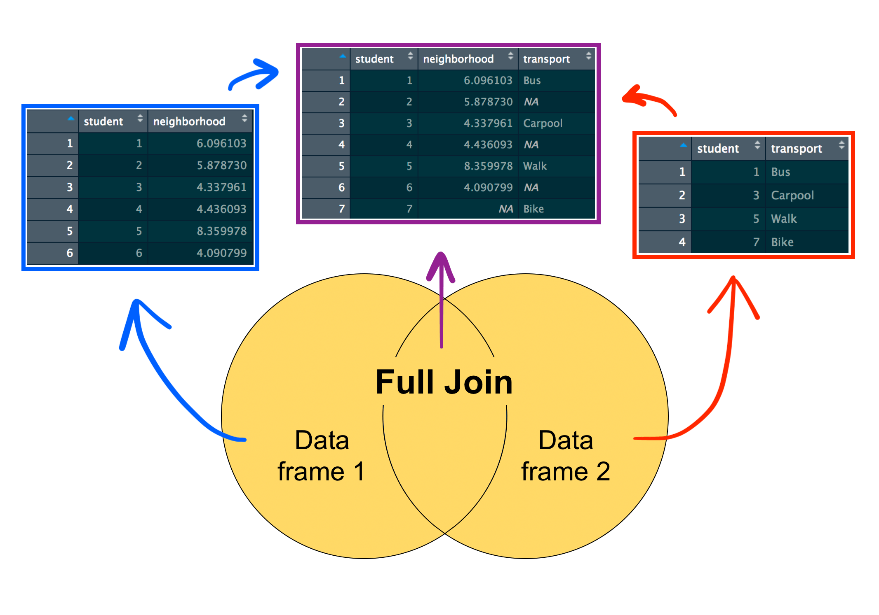
Worked Example
SLIDE 8 / 14
Lossless Join
1
Relation R(A, B, C) with FDs: A → B, B → C.
2
Decompose into R1(A, B) and R2(B, C).
3
Intersection is B, which is a key for R2 because B → C.
4
Since B is a key for R2, the decomposition is lossless.
5
Joining R1 and R2 on B reconstructs R without spurious tuples.
Source: www.rforecology.com
Chandigarh University
8 / 14
Notes:
Let's look at a concrete example. We have a relation with attributes A, B, and C. We split it into R1 and R2 sharing attribute B. Since B determines C in R2, B is a key there. This satisfies our condition, so the join is lossless. We can safely reconstruct the original data.

Slide 9
Worked Example
SLIDE 9 / 14
Lossy Join
1
Relation R(A, B, C) with FDs: A → B, C → B.
2
Decompose into R1(A, B) and R2(B, C).
3
Intersection is B, which is not a key for R1 or R2.
4
Joining R1 and R2 creates spurious tuples not in the original relation.
5
This decomposition is lossy and violates the lossless join condition.
Source: www.rforecology.com
Chandigarh University
9 / 14
Notes:
Now consider a case where B is not a key for either part. If we join R1 and R2, we might get rows that never existed. For instance, a combination of A and C that wasn't in the original table. This creates garbage data, making the decomposition lossy and unsafe for production use.

Slide 10
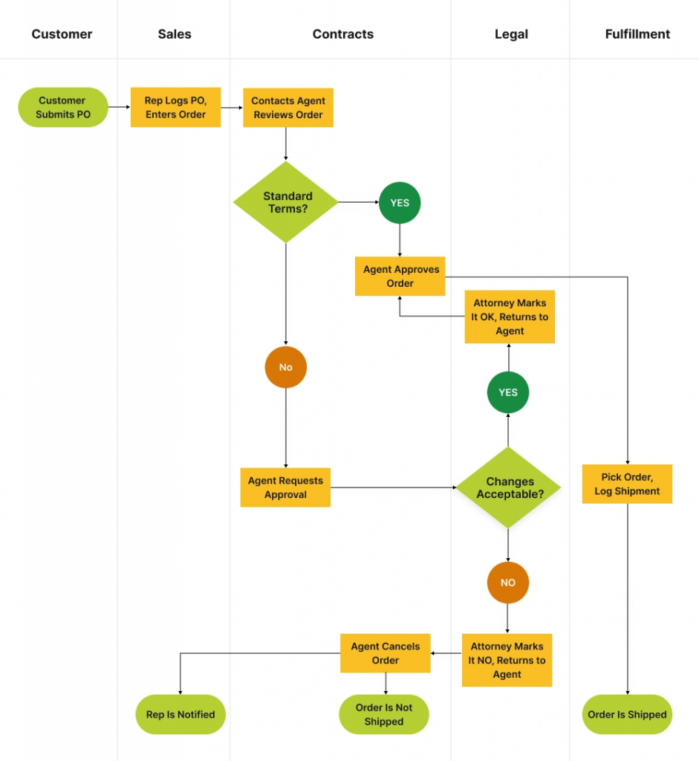
Lecture
SLIDE 10 / 14
Checking Dependency Preservation
1
Compute the closure of the original functional dependencies for each sub-relation.
2
Union the closures of all sub-relations to form the new dependency set.
3
Check if the original dependencies can be derived from this new set.
4
If the closure of the union equals the closure of the original set, it is preserved.
5
This process ensures no constraints are lost during the decomposition process.
Source: www.invensislearning.com
Chandigarh University
10 / 14
Notes:
To check if dependencies are preserved, we calculate the closure of dependencies for each new table. We then combine these closures and see if we can still derive the original rules. If the combined set implies all original rules, we have successfully preserved the dependencies. This is a rigorous mathematical check.

Slide 11
Lecture
SLIDE 11 / 14
Common Pitfalls in Decomposition
1
Assuming any decomposition into 3NF is automatically lossless and dependency preserving.
2
Ignoring the intersection condition when verifying the lossless join property.
3
Failing to check if functional dependencies are enforceable without joins.
4
Over-normalizing a schema which leads to excessive join operations for queries.
5
Neglecting to verify both properties simultaneously for a robust database design.
Chandigarh University
11 / 14
Notes:
Students often make the mistake of assuming 3NF is always perfect. It is not. You can have a 3NF decomposition that is lossy or loses dependencies. Always check the intersection condition for lossless joins. Also, ensure you can enforce rules without joining tables. These pitfalls can lead to inefficient and incorrect systems.

Slide 12
Lecture
SLIDE 12 / 14
Chase Algorithm Overview
1
The chase algorithm is a systematic method to test for lossless joins.
2
It uses a tableau to track how tuples transform under functional dependencies.
3
If a row becomes all identical symbols, the decomposition is lossless.
4
This algorithm works for any set of functional dependencies and relations.
5
It provides a definitive proof for the lossless join property in complex cases.
Chandigarh University
12 / 14
Notes:
For complex cases, we use the chase algorithm. It involves creating a table of symbols and applying functional dependencies to change them. If we end up with a row of identical symbols, the join is lossless. This is a powerful tool for proving properties in advanced database design scenarios.

Slide 13
Lecture
SLIDE 13 / 14
Key Takeaways
1
Lossless join ensures the original relation is perfectly reconstructed after decomposition.
2
The intersection of sub-relations must be a superkey for at least one part.
3
Dependency preservation allows checking constraints without performing expensive join operations.
4
Both properties are critical for a robust and efficient database normalization strategy.
5
Always verify these conditions before finalizing any database schema decomposition.
Chandigarh University
13 / 14
Notes:
To summarize, a lossless join means no data is lost or added. The intersection must be a key. Dependency preservation means we can check rules easily. Both are essential for good design. Always verify these before finalizing your schema.

Slide 14
Lecture
SLIDE 14 / 14
References
1
Fundamentals of Database Systems — Ramez Elmasri & Shamkant B. Navathe
2
Database System Concepts — Silberschatz, Korth & Sudarshan
3
Database Management Systems — Raghu Ramakrishnan & Johannes Gehrke
4
Oracle/MySQL Documentation — Oracle
Chandigarh University
14 / 14
Notes:
For further reading, please refer to the standard texts by Elmasri, Silberschatz, and Ramakrishnan. These books provide deep insights into normalization and decomposition. The Oracle documentation is also excellent for practical implementation details. Thank you for your attention today.

